Slide 1
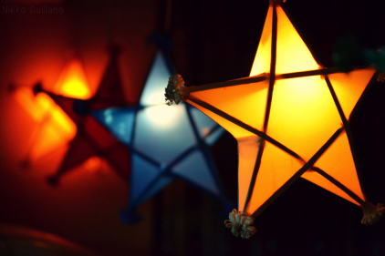
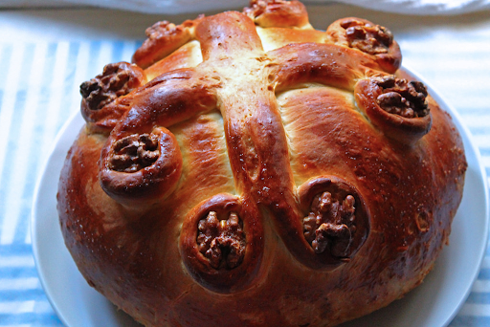
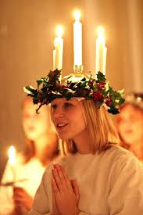
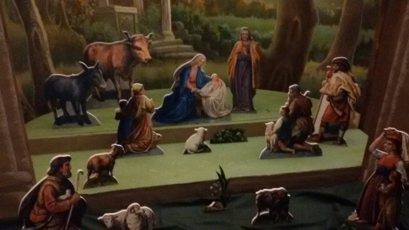
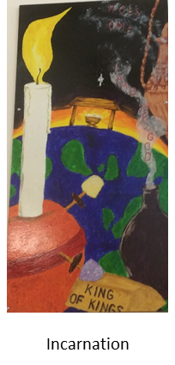
Y5/6 Do all Christians celebrate Christmas in the same way?
Key Vocabulary
Saint Nicholas | Early Christian bishop the inspiration for Father Christmas patron saint of children
Saint Lucia | Early Christian martyr celebrated in Sweden on 13th December
Orthodox Christianity | Second largest Christian denomination with 220million followers
Christopsomo | Greek “Christ’s bread” considered sacred
presepio | Italian nativity scene from the Latin word for crib
parol | Filipino ornamental lamp used at Christmas
Prior learning Experienced taking part in a Nativity play. Are familiar with the main aspects of the story. Have studied the story through the lens of symbols, good news, a festival of light and incarnation.
Key Learning Self-Assessment
I know:
Christmas is celebrated worldwide.
that not all of the celebrations are linked to the nativity story.
many Orthodox Christians celebrate Christmas in early January
I can:
describe different Christmas celebrations around the world.
give reasons for different Christmas celebrations around the world.
make links between the story, belief and actions.
talk about the distinctive Christian beliefs in the Christmas celebrations.
ask relevant questions using religious vocabulary.
Big Ideas Key Concepts

